Slide 1
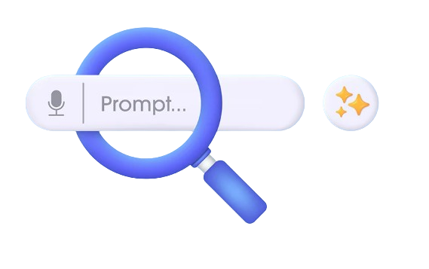
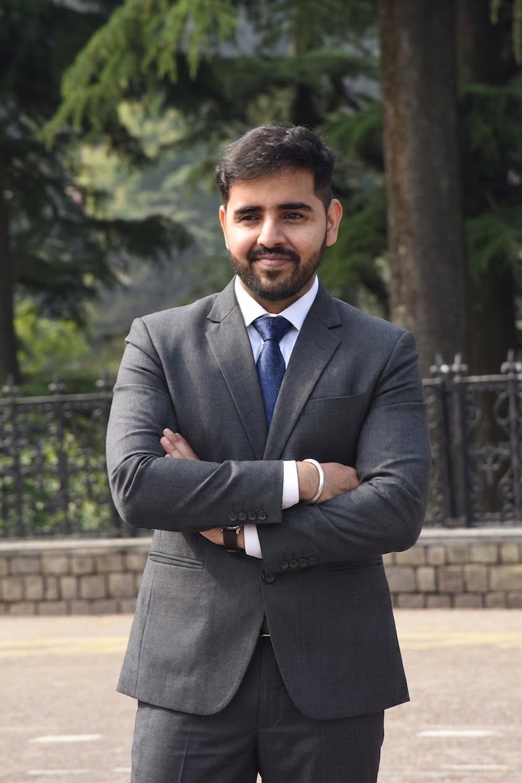
INTRODUCING
PROMPT
ENGINEERING
Prompt Engineering is the art of designing effective inputs to guide AI models towards optimal outputs. This introduction sets the stage for mastering this crucial skill.
Presented By :
Shubham Ranjan

Slide 2
PROMPTING?
The art of crafting precise inputs (prompts) to guide an AI model towards generating the desired output.
AI MODEL
PROMPT
RESPONSE
WHY PROMPTING MATTERS
BETTER RESULTS: Obtain more accurate and relevant outputs.
EFFICIENCY: Save time by reducing iteration cycles.
CONTROL: Steer AI behaviour and style effectively.
INNOVATION: Unlock new possibilities in creation & problem - solving.

Slide 3
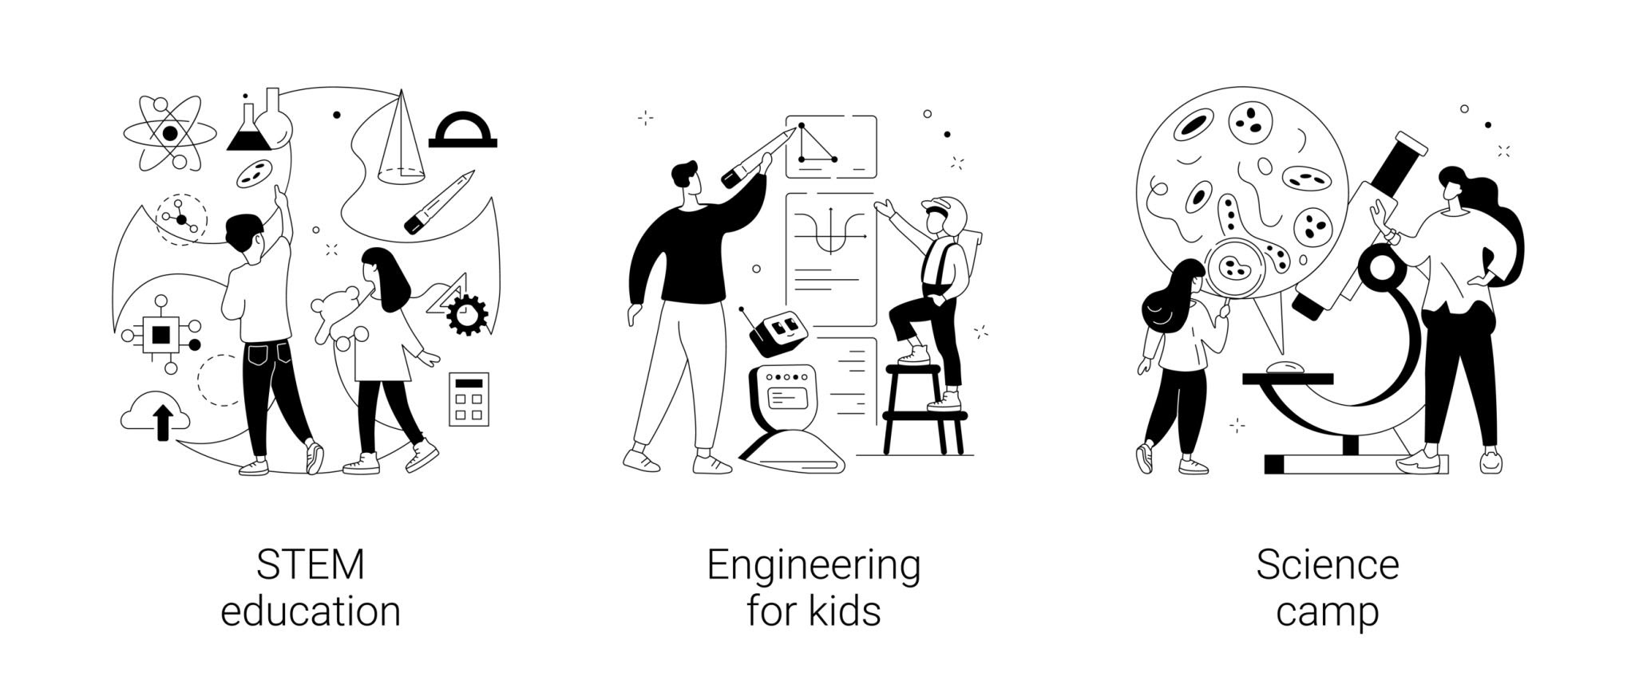
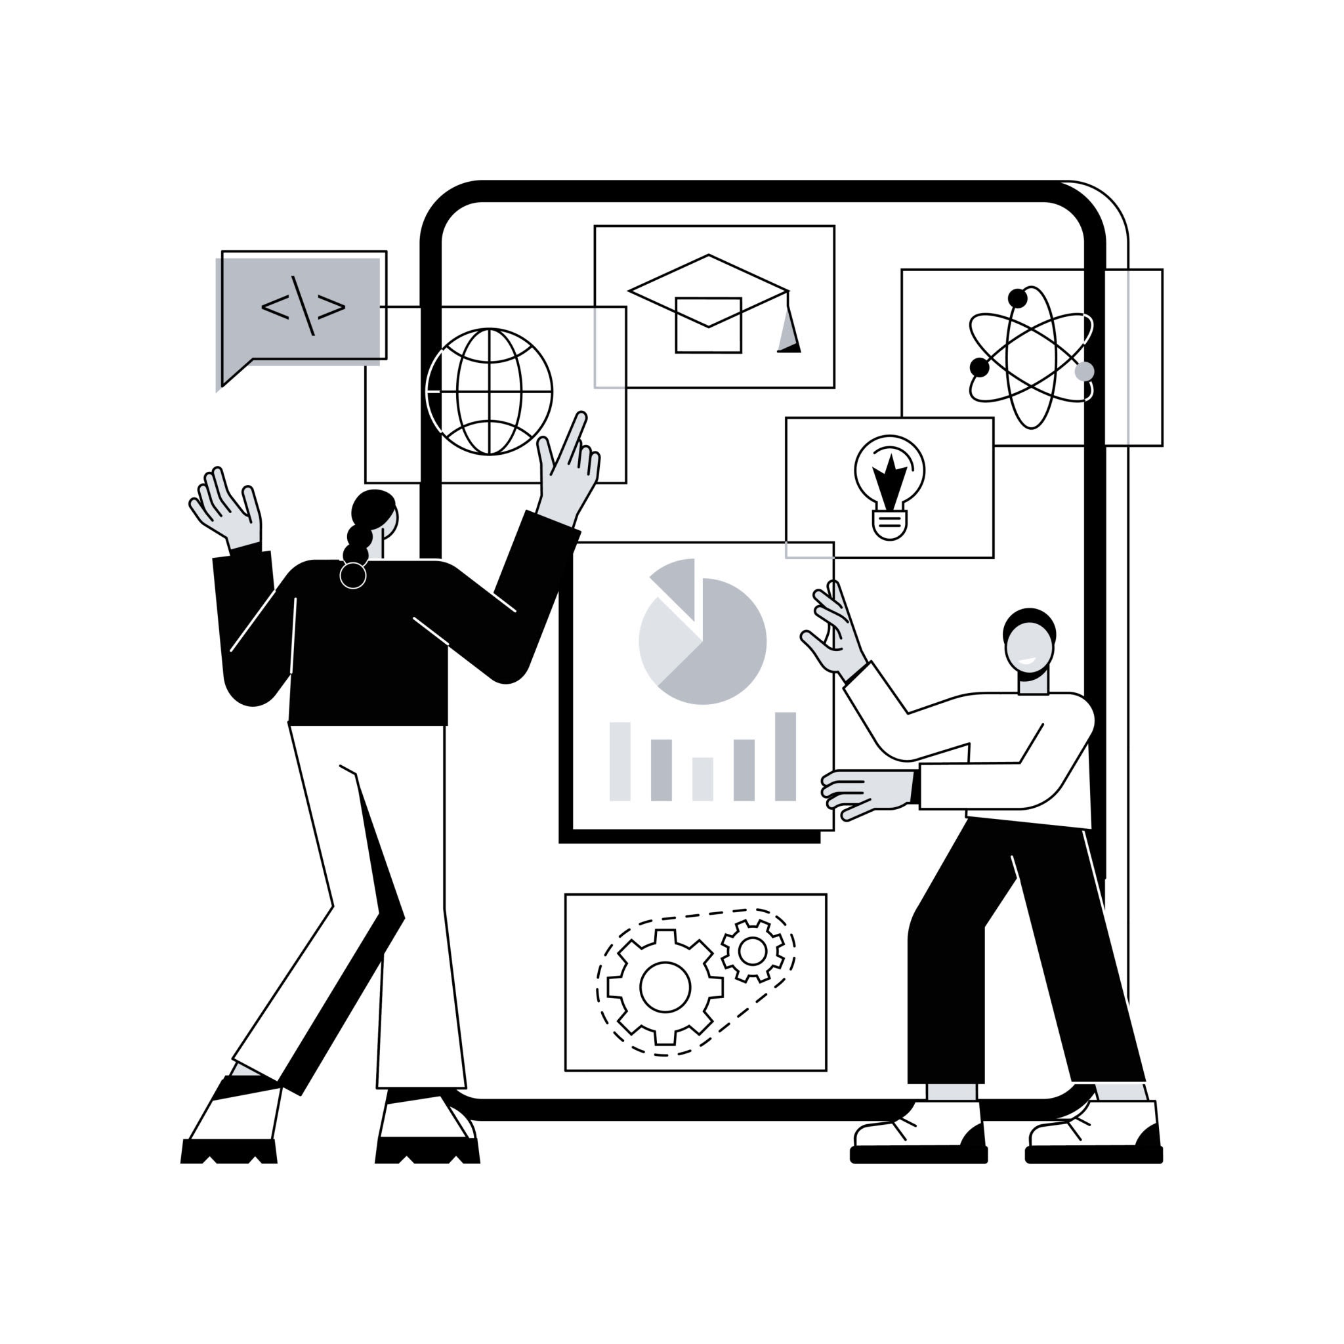

LET’S DO SOME LIVE ACTIVITIES

Slide 4

Prompt Anatomy
Prompting Techniques
The building blocks every good prompt shares
Role
Tell the model who it is
Zero-Shot
Few-Shot
Context
Situation, background, constraints
Chain of Thought
Role Prompting
Task
Clear, specific instruction
Format
Output shape — length, structure, tone
Constraint-Based
Iterative Refinement
Examples
Few-shot anchors (optional but powerful)
Notes:
SLIDE 2 — PROMPT ANATOMY (teach before first exercise)
Walk through each row of the anatomy table before the coffee-ad exercise.
ROLE
→ Sets the model's expertise level, vocabulary, and authority
→ "You are a senior copywriter" produces very different output than no role at all
→ Common mistake: assigning a role that doesn't match the task (e.g. "helpful assistant" writing legal briefs)
CONTEXT
→ Who is the client? Who is the audience? What are the constraints?
→ The model has no memory — everything it needs to know must be in the prompt
TASK
→ The actual deliverable. Must be specific: not "write an ad" but "write 3 Facebook ad copy variations, each with hook + body + CTA"
FORMAT
→ Output shape: bullet points or paragraphs? Max words? Number of variations?
→ Without a format anchor, the model picks one — and it's usually not what you pictured
EXAMPLES (Few-shot)
→ Optional but powerful. Show the model exactly what good looks like.
→ Tone-matching, structure-matching, register-matching — all handled by example
---
RIGHT SIDE — Prompting Techniques (mention briefly, will be demonstrated in exercises):
- Zero-Shot: detailed instructions, no examples
- Few-Shot: 2–3 examples to anchor tone/format
- Chain of Thought: step-by-step reasoning before conclusion
- Role Prompting: persona assignment
- Constraint-Based: banned words, word counts, required structure
- Iterative Refinement: the meta-skill — start rough, improve each round
Tell the room: "Every exercise today demonstrates one of these techniques. By the end you'll have used all of them."

Slide 5

Live Exercises
Weak → Better → Best — spot the upgrade
01
Coffee Ad
02
Create Beach Image
03
Sales Manager
Zero-Shot
Few-Shot
Role Based
Task
Task
Task
Write an Ad for a new coffee brand.
Create beach image for travel blog
Analyze sales report for 3rd quarter
Best prompt includes:
Best prompt includes:
Best prompt includes:
Give brand name
3 variations with Hook + Body + CTA
Banned: 'premium', 'perfect'
Tone: confident, never salesy
2 example scenes for reference
Set the theme
Define the subject
Include supporting details
Specify style
Define role as Sales Manager
Specify the goal
Key context or report details
Key Insights
Output format
Negative Instruction
Notes:
SLIDE 3 — THREE EXERCISES (run live, ~20–25 min total)
EXERCISE 01 — COFFEE AD (Zero-Shot)
Setup: Give room 2 minutes to write "an ad for a new coffee brand" — no guidance.
After collecting, reveal the 3 tiers:
WEAK: "Write an Ad for a new coffee brand."
BETTER: Adds Facebook, target age 28–40, morning ritual angle, 60-word limit
BEST: Role + client brief + 3 variations required + hook/body/CTA structure + banned words list
Debrief questions:
→ What did the weak prompt leave open? (format, tone, audience, platform, purpose)
→ What does the banned-words rule force the model to do? (avoid defaults)
→ Why "not Shop Now" as a CTA constraint? (predictability prevention)
---
EXERCISE 02 — LAW FIRM EMAIL (Few-Shot)
Setup: Show all 3 versions — participants don't write this one, just read.
Key teaching: The Best prompt shows the model 2 examples before asking for the real output.
The model mirrors:
→ Measured, professional tone (no emotion, no hedging)
→ Specific structure: what happened → next step → action needed from client
→ Concrete date placeholders
Ask the room: "What would happen if you sent the weak version?" (answer: generic corporate email, no reassurance, wrong register)
Note: This is also a good moment to mention that few-shot anchors work for ANY professional writing — proposals, performance reviews, client summaries.
---
EXERCISE 03 — PATIENT TRIAGE (Chain of Thought)
Key teaching: CoT forces the model to reason before concluding.
Walk through the 5 steps:
Step 1 — Forces symptom inventory (chest tightness, 2 days, worse mornings)
Step 2 — Pulls relevant history (hypertension + amlodipine)
Step 3 — Red flag check (chest tightness + hypertension = cardiac screening)
Step 4 — Gap analysis (family history unknown, stress reported)
Step 5 — The actual summary
Ask the room: "Why does it matter that the model shows its reasoning?"
→ In medical/legal/financial contexts, the reasoning IS the output — you need to audit it
→ CoT also catches hallucinations: if the chain is wrong, you catch it before the conclusion is acted on

Slide 6
Prompt Debugging
Read the bad output as a mirror — the bug is always in the prompt
THE 5 BUGS
CASE: SKINCARE TAGLINE
01
Conflicting instructions
❌ Bad prompt 1
Fix: Pick one register; rule out the other
Write a premium yet casual skincare tagline that sounds scientific but also fun and emotional. Keep it short but also descriptive.”
02
Underspecified task
Fix: Add: for whom? How long? What to emphasise?
❌ Bad promp
“Create a skincare slogan that people will like. Make it catchy.”
03
Missing format anchor
Fix: Specify structure, sections, output shape
❌ Bad prompt
04
Role mismatch
“As a dermatologist, write a bold rebellious tagline for a skincare brand that disrupts the industry and sounds poetic.”
Fix: Match role to task expertise level
05
Ambiguous scope
Fix: Define the improvement goal explicitly
Notes:
SLIDE 4 — PROMPT DEBUGGING (20 min)
Core teaching: "Every bad output is a clue. The bug is always in the prompt."
THE 5 BUGS — go through these before the exercise:
1. Conflicting instructions → asked for "formal + conversational" at same time → model averaged them
2. Underspecified task → "summarise this" → summarise how, for whom, how long?
3. Missing format anchor → described what you wanted, not what it should look like → model picks a structure
4. Role mismatch → "helpful assistant" writing legal brief → sounds like a chatbot, not a lawyer
5. Ambiguous scope → "rewrite this to be better" → better HOW?
---
CASE: SKINCARE TAGLINE EXERCISE (Exercise 7)
STEP 1 — Show participants the original prompt:
"Write a tagline for our skincare brand. We want something emotional and memorable. The brand is called Bare. We sell minimalist, clean skincare for people who are tired of complicated routines."
STEP 2 — Show the bad output:
"Bare: Pure. Simple. Effective. Clean skincare for a cleaner you. Because you deserve the best, naturally."
Ask room: What's wrong? Give 2 minutes.
Expected answers:
- Sounds like every other skincare brand
- "Because you deserve the best" is a cliché
- "Cleaner you" is awkward
- No actual emotion — just adjectives stacked
- Brand name not used cleverly
STEP 3 — Diagnose the 3 bugs:
Bug 1: "Emotional and memorable" — every brand wants that. What emotion specifically? Relief? Self-acceptance?
Bug 2: No negative constraints — "clean skincare" statistically defaults to generic wellness register
Bug 3: "Minimalist" describes the product, not the voice — is this quiet luxury or anti-BS challenger?
STEP 4 — Show the fix:
Key additions: specific feeling (relief, not aspiration), banned word list (pure/clean/simple/natural/effective/deserve/best), double-meaning instruction for "Bare"
Output: "Bare. Nothing to prove." / "Stop performing. Start Bare."
KEY TAKEAWAY — say this explicitly:
"The fix was not rewriting from scratch. It was diagnosing three specific gaps and patching exactly those. Most people, when shown a bad output, say they'd change everything. The skill is changing only what caused the problem."
CLOSE: Ask the room — if you received the bad output right now, what would you have changed first? Compare answers.

Slide 7
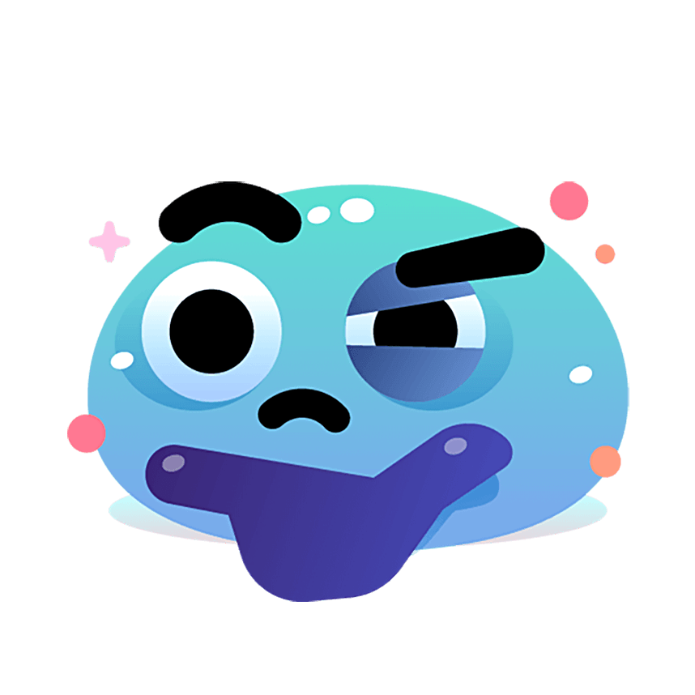
QnA?

